Slide 1

IMDB MOVIE ANALYSIS

Slide 2
Project Description
The project titled "IMDb Movie Analysis" focuses on leveraging data analysis techniques to investigate trends and patterns within movie information on IMDb.
This project utilizes a dataset containing various attributes about movies, including title, release year, director, cast members, user ratings, number of ratings received, genre classifications, runtime, production budget, revenue generated, and a popularity metric.
By employing descriptive statistics and data visualization tools, the project aims to answer intriguing questions about the world of cinema.

Slide 3
Project Approach
Here's a breakdown of the approach:
Data Manipulation and Analysis: Excel functions and formulas will be employed to manage the data. This includes sorting movies based on specific criteria, filtering the data to focus on relevant subsets, and applying conditional formatting for visual emphasis. Additionally, pivot tables and charts will be used to summarize and visually represent the data, aiding in identifying patterns and trends.
Interactive Dashboards and Reports: To present the findings in a clear and engaging way, the project will incorporate interactive features within Excel. Slicers will allow viewers to dynamically filter the data based on their interests. Timelines can be used to explore trends over time, while data validation ensures the accuracy of user input. These elements will culminate in interactive dashboards and reports that effectively communicate the insights gleaned from the analysis.
Following the Data Analysis Process: The project will adhere to a structured approach. We'll begin by clearly defining the research questions we aim to answer. Next, we'll collect the IMDb movie data and ensure its quality through cleaning techniques. Following this, the exploration and analysis phase will involve delving into the data using the methods mentioned above. Finally, the project will culminate in clear communication of the results through interactive dashboards and reports.

Slide 4
Tech Stack Used
I have used MS Office LTSC Professional Plus 2021 version for my project -
MS Excel:
Numerical Data: Storing and manipulating numbers, performing calculations using formulas and functions, and creating financial models.
Data Tables and Charts: Organizing large datasets into rows and columns, and generating various charts and graphs to visually represent trends and patterns.
Data Analysis Tools: Offering features like pivot tables for summarizing data, sorting and filtering for focused analysis, and conditional formatting for highlighting important information.
MS PowerPoint:
Slide Creation: Build compelling presentations using a variety of layouts for text, images, charts, and graphs.
Visual Storytelling: Enhance your message with multimedia elements like pictures, videos, and sound effects, bringing your presentation to life.
Customization: Tailor your presentation to your audience and brand with a wide range of design themes, fonts, and color schemes.
Delivery Tools: Projector support, presenter notes, and speaker view with a countdown timer empower you to deliver a confident and engaging presentation.

Slide 5
Data Cleaning
The initial dataset contained 28 columns and 5043 rows. However, upon closer inspection, it was determined that:
Unnecessary Columns: Certain columns lacked relevance to the project and wouldn't contribute valuable insights. These extraneous columns were removed, resulting in a streamlined dataset with only the most pertinent information.
Blank Rows: The presence of blank rows within the data was identified. To address this, a "Find & Select" function was employed. By utilizing the "Go to special" option and selecting "Blanks," all empty rows were highlighted. Subsequently, the "Ctrl + -" shortcut with the "Entire rows" option effectively eliminated these unnecessary rows.
Duplicate Rows: The dataset was further refined by removing duplicate entries. This step ensured data consistency and prevented skewed analysis.
Correcting Movie Title: On observing the “movie_title” columns depicted an extra “Â” character attached to it, which was then removed and updated using substitute function under the column “Movie_Name”
Cleaned Dataset Outcome:
Following the data cleaning procedures, the final dataset maintains a structure of 9 columns and 3786 rows. This refined dataset provides a more focused and reliable foundation for further analysis.

Slide 6
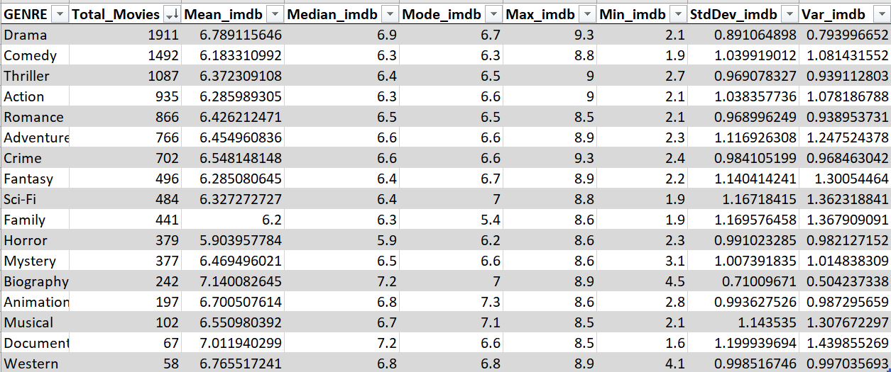
TASKS
Movie Genre Analysis:
Analyze the distribution of movie genres and their impact on the IMDB score.
TASK : Determine he mtost common genres of movies in the dataset. Then, for each genre, calculate descriptive statistics (mean, median, mode, range, variance, standard deviation) of the IMDB scores.

Slide 7
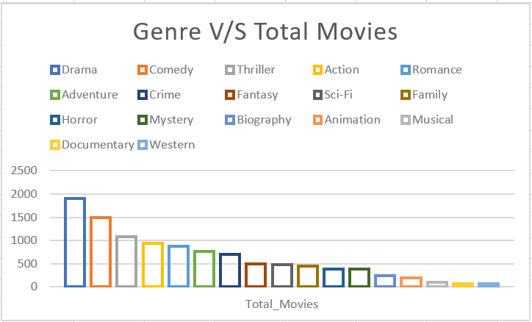
Insight: 1). The graph below depicts the genre against the total number of movies. 2). Where Drama category leads in genre and western being the least

Slide 8
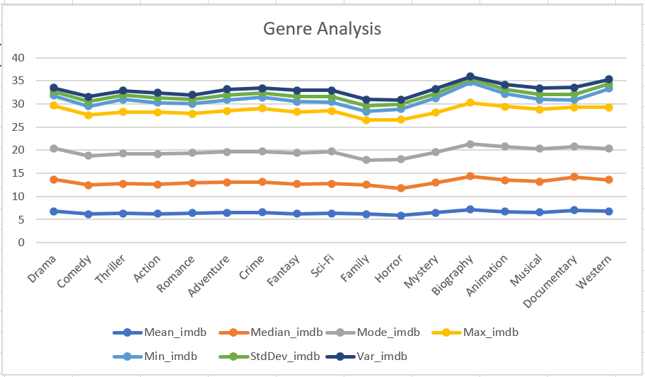
Insight: 1). The graph below depicts the statical measures calculated against the different genres of movie. 2). The descriptive statistics calculated for movie genres are – Mean, Median, Mode, Max, Min, Var and StdDev.

Slide 9
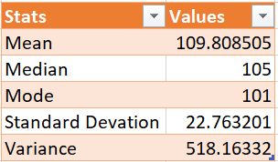
B) Movie Duration Analysis: Analyze the distribution of movie durations and its impact on the IMDB score.
Task : Analyze the distribution of movie durations and identify the relationship between movie duration and IMDB score.

Slide 10
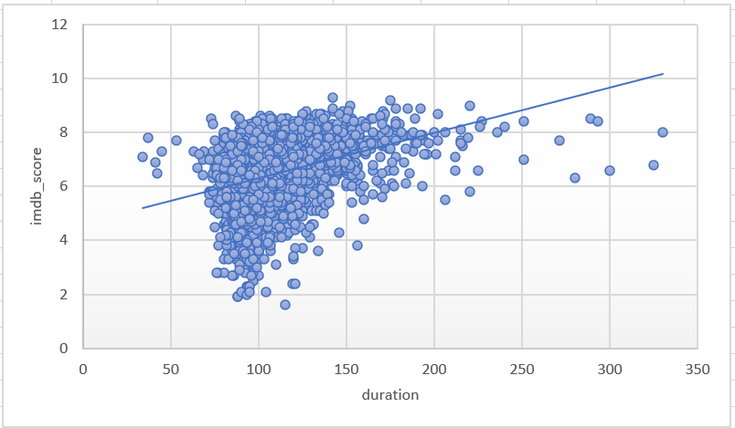
Insight: 1). The below graph represents the imdb_score against the duration of the movie 2). The trendline shows that the movie having duration between 100 to 150 tends to have higher imdb score.

Slide 11
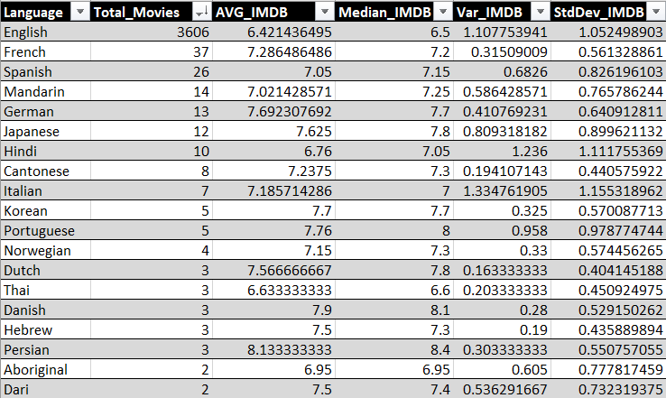
C) Language Analysis: Situation: Examine the distribution of movies based on their language.
TASK: Determine the most common languages used in movies and analyze their impact on the IMDB score using descriptive statistics.

Slide 12
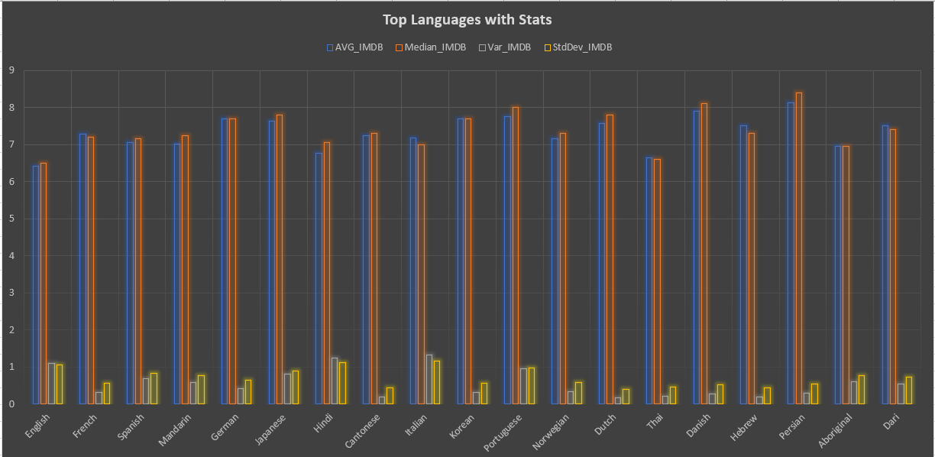
Insight: 1). The below graphs shows Top languages along with some statistical measures such as Average, Median, Variance and Standard Deviation. 2). The graph is calculated by taking into account the Top 20 languages. 3). English has the Highest number of movies i.e. 3606. 4). Whereas Persian movies have the highest average of imdb of 8.4

Slide 13
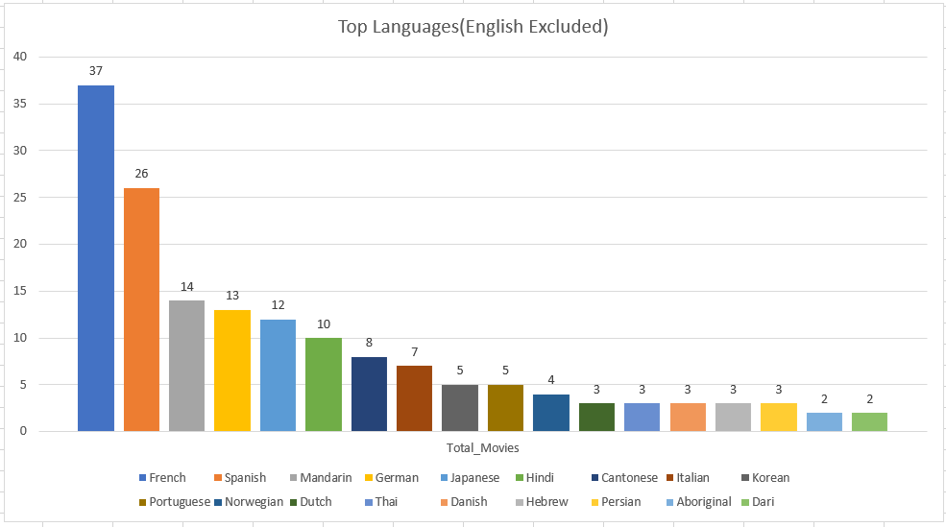
Insight: 1). Below graph has most common languages used in movies. 2). As English being the most dominant in the list of languages with 3606 is being excluded from the list 3). This was done to provide a better insight of the other most common language used. 4). French came out to be the most common language after English.

Slide 14
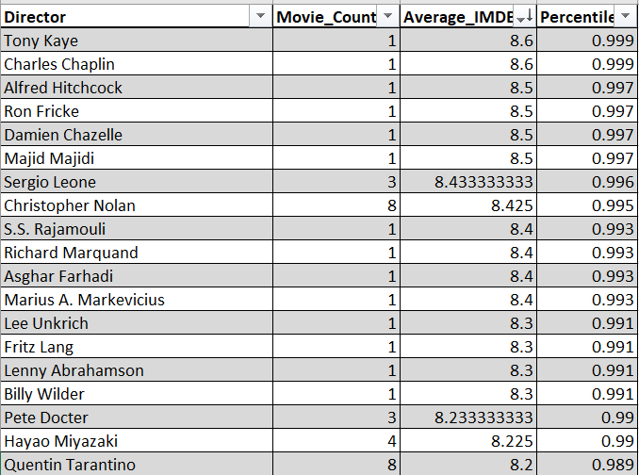
D) Director Analysis: Influence of directors on movie ratings.
TASK : Identify the top directors based on their average IMDB score and analyze their contribution to the success of movies using percentile calculations.

Slide 15
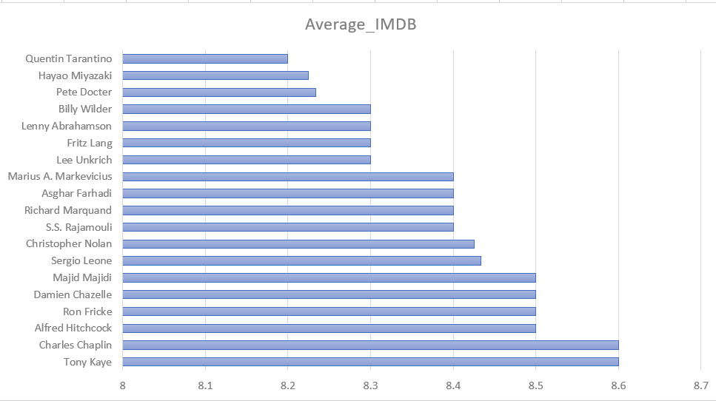
Insight: 1).According to the graph below- Tony Kaye and Charles Chaplin has the highest average imdb score for a director. 2). But Tony and Charles has done only one movie, Christopher Nolan And Quentin Tarantino has a better performance with 8.4 And 8.2 imdb score respectively with 8 movies each.

Slide 16
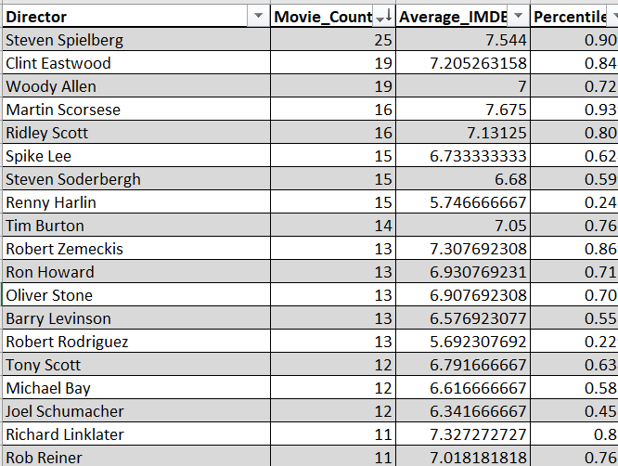
Additional Insight:

Slide 17
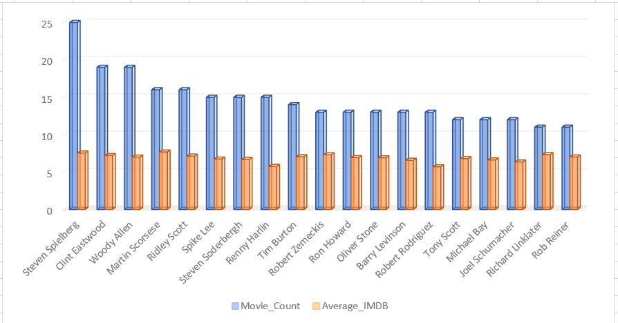
1). The previous insight was calculated on the basis of average imdb score of directors. 2). In this additional insight I have taken into account the number of movies directed by a director too along with their average imdb score. 3). According to which Steven Spielberg turn out to be the director with highest average imdb score with having directed over 25 movies in his career.

Slide 18
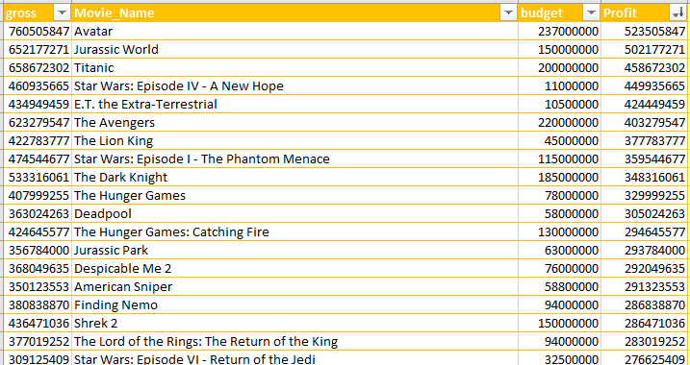
E) Budget Analysis: Explore the relationship between movie budgets and their financial success.
TASK : Analyze the correlation between movie budgets and gross earnings, and identify the movies with the highest profit margin.

Slide 19
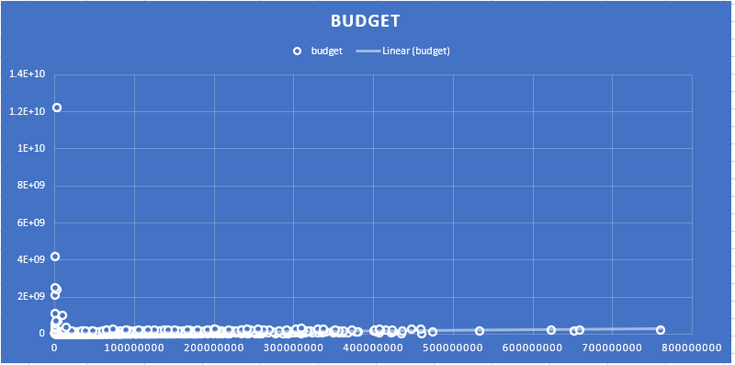
Insight: The graph below is plotted against gross collection of movies and their budget

Slide 20
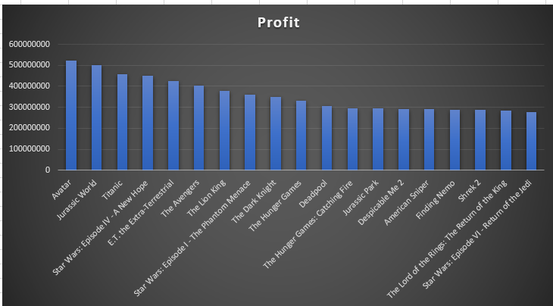
Insight: 1). The below graph shows Top grossing movies along with their Profit margins. 2). The list contains the top 20 movies with highest profit margins. 3). Avatar tops the list with the highest profit margin.

Slide 21
Conclusion
Key Findings from the IMDb Movie Analysis Project:
Genre Popularity: Drama, Comedy, Thriller, and Action dominate the dataset, suggesting a preference for these genres among moviegoers.
Duration and Ratings: The average movie length is 109 minutes. There's a slightly positive trend (indicated by an upward sloping line) between movie duration and IMDb score. However, the R-squared value of 0.131 suggests this correlation is weak. In other words, movie length doesn't significantly impact ratings.
Language Distribution: English, French, Spanish, Mandarin, and German are the most common languages used in the movies. Interestingly, Telugu and Persian films boast the highest average IMDb scores, suggesting a potential preference for films in these languages within their respective audiences.
Acclaimed Directors: Ten directors stand out with an average IMDb score of 8.4 or higher: Tony Kaye, Charles Chaplin, Alfred Hitchcock, Ron Fricke, Damien Chazelle, Majid Majidi, Sergio Leone, Christopher Nolan, S. S. Rajamouli, and Richard Marquand. These filmmakers consistently deliver high-quality cinema, as reflected in the audience ratings.
Box Office Success: The top five highest-grossing films are Avatar, Jurassic World, Titanic, Star Wars: Episode IV - A New Hope, and E.T. The Extra-Terrestrial. Not surprisingly, there's a positive correlation between a movie's budget and its gross earnings. In simpler terms, films with larger budgets tend to generate higher revenue.

Slide 22
5 “Why” Approach
With the conclusion derived from the project we could also go with the 5 “why” approach-
Why is Drama the most watched genre among the moviegoers?
Ans) It is because Drama genre can be enjoyed by people of all age groups.
Why does length of a movie matter for higher imdb rating?
Ans) It could be because long movies could be boring or shorter movie than average length have rushed story.
C) Why is English the most common language used in movies?
Ans) So that the movie could reach a wider audience, English being the global language is mostly used.
D) Why producer tend to hire acclaimed directors?
Ans) It is because acclaimed director tends to deliver a movie with higher imdb score, which in turn lead to better profit margins.
Why does positive correlation with budget and it’s gross earning tell?
Ans) This simply tells that movie with higher budget tends to generate higher revenues.

Slide 23
RESULT
This project wasn't simply about analyzing movie data; it was about unlocking a deeper understanding of what makes a film resonate with audiences and achieve commercial success. We ventured into the vast repository of information on IMDb, a treasure trove for movie enthusiasts, and employed data analysis techniques to illuminate various facets of both the films themselves and the viewers who consume them.

Slide 24
THANK YOU

